Slide 1
Topic 3 Chemical Bonding

Slide 2
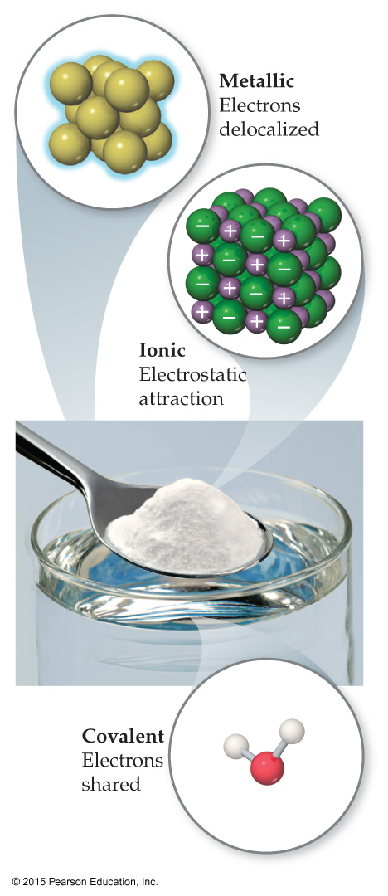
Chemical Bonds
Three basic types of bonds
Ionic
Electrostatic attraction between ions.
Covalent
Sharing of valance electrons.
Metallic
Metal atoms bonded to several other atoms by electrostatic attraction between metal cations and delocalized electrons.

Slide 3
Covalent Bonding

Slide 4
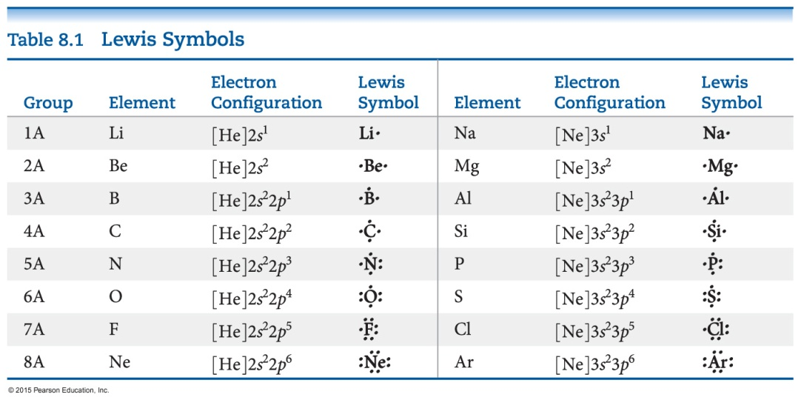
Lewis Symbols
G. N. Lewis developed a method to denote potential bonding electrons by using one dot for every valence electron around the element symbol.
When forming compounds, atoms tend to gain, lose, or share electrons until they are surrounded by eight valence electrons (the octet rule).

Slide 5

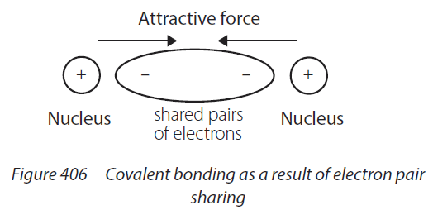
Covalent bonding

Slide 6
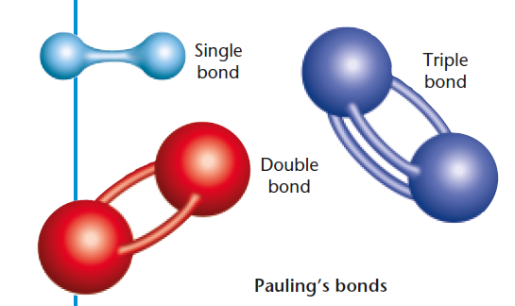

Multiple Bonds
Some atoms share only one pair of electrons. These bonds are called single covalent bonds. F₂
Sometimes, two pairs need to be shared. These are called double covalent bonds. O₂
There are even cases where three bonds are shared between two atoms. These are called triple covalent bonds.
Bond order is the number of chemical bonds between a pair of atoms and indicates the stability of a bond.

Slide 7
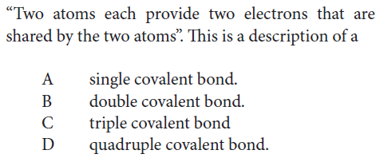
Practice

Slide 8
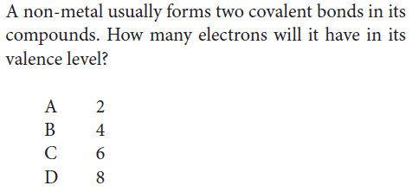
Practice

Slide 9
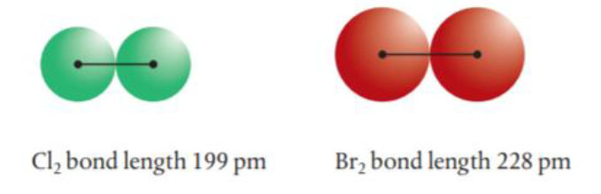
Covalent bond length and strength
As atomic radius increases as we go down a group, we would expect the atoms to form molecules with longer bonds.
As a result, the shared electron pair is further from the pull of the nuclei in the larger molecules, and so the bond would be expected to be weaker.

Slide 10
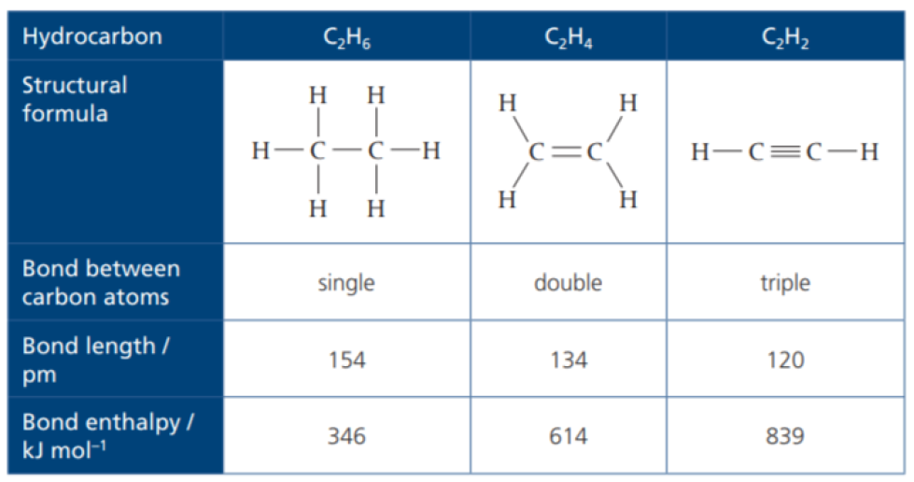
Bond Order and bond strength
Multiple bonds have a greater number of shared electrons and so have a stronger force of electrostatic attraction between the bonded nuclei. This means there is a greater pulling power on the nuclei, bringing them closer together, resulting in bonds that are shorter and stronger than single bonds.

Slide 11
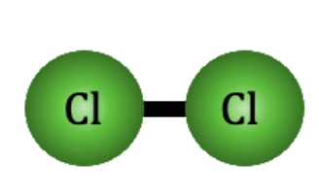
Polarity of bond
Nonpolar Covalent Bond
A bond between 2 nonmetal atoms that have the same electronegativity and therefore have equal sharing of the bonding electron pair
Example: In Cl-Cl each Cl atom has an electronegativity value of 3.1, therefore the covalent bond between them is considered nonpolar

Slide 12
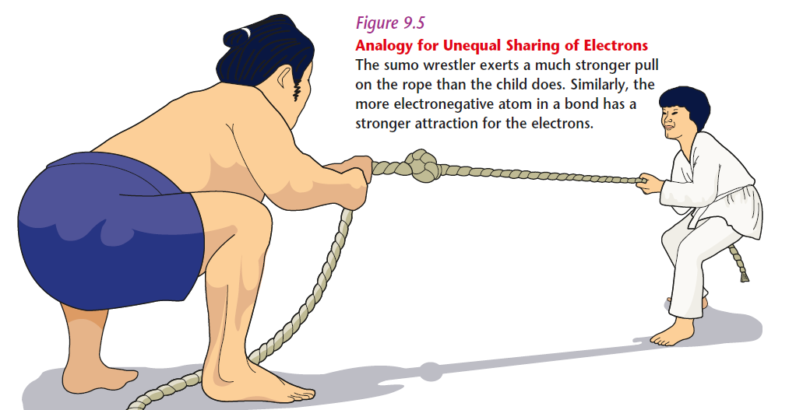
Polarity of bond
When there is a difference in the electronegativities of the bonded atoms as the more electronegative atom exerts a greater pulling power on the shared electrons and so gains more ‘possession’ of the electron pair.

Slide 13
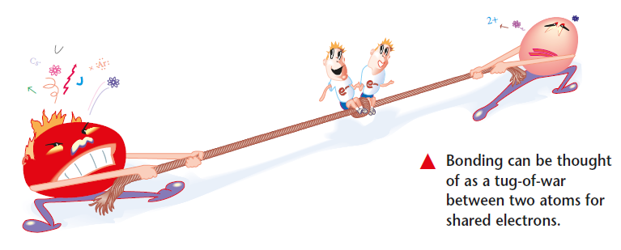
Polarity of bond
The bond is now unsymmetrical with respect to electron distribution and is said to be polar.

Slide 14

Electronegativity and Polar Covalent Bonds
When two atoms share electrons unequally, a polar covalent bond results.
Electrons tend to spend more time around the more electronegative atom. The result is a partial negative charge (not a complete transfer of charge). It is represented by δ–.
The other atom is “more positive,” or δ+.

Slide 15
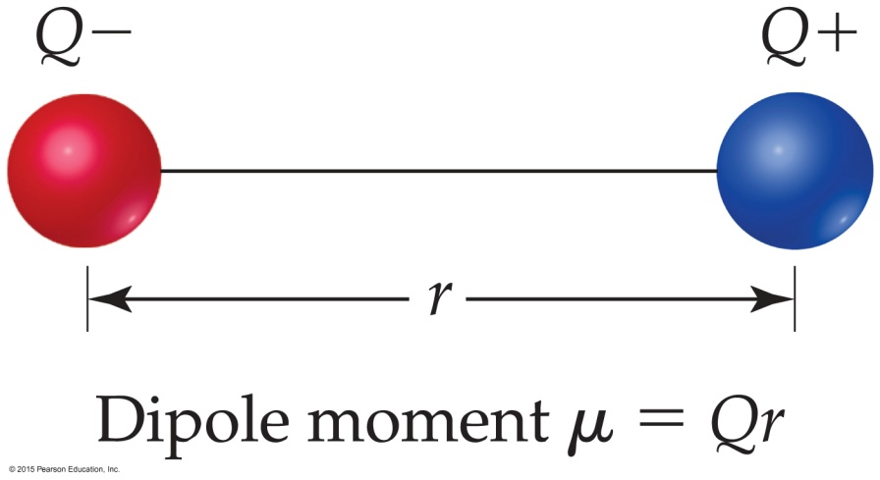
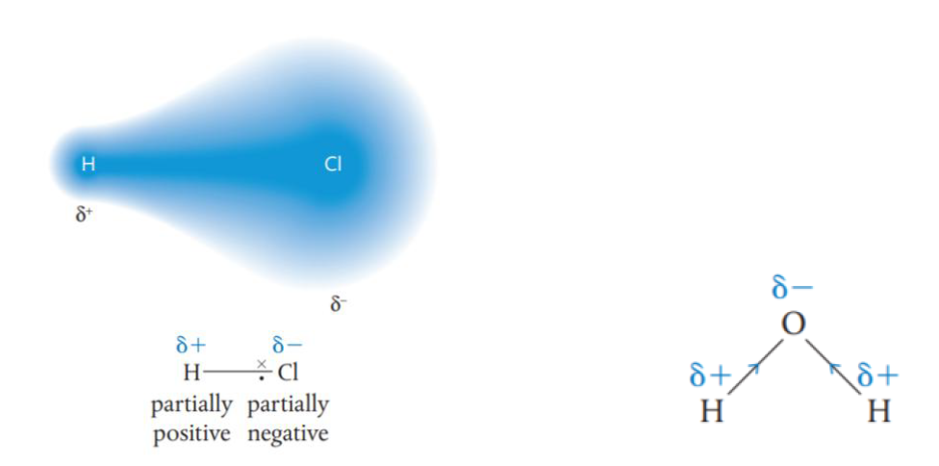
Dipoles
When two equal, but opposite, charges are separated by a distance, a dipole forms.
A dipole moment, μ, produced by two equal but opposite charges separated by a distance, r, is calculated:

Slide 16
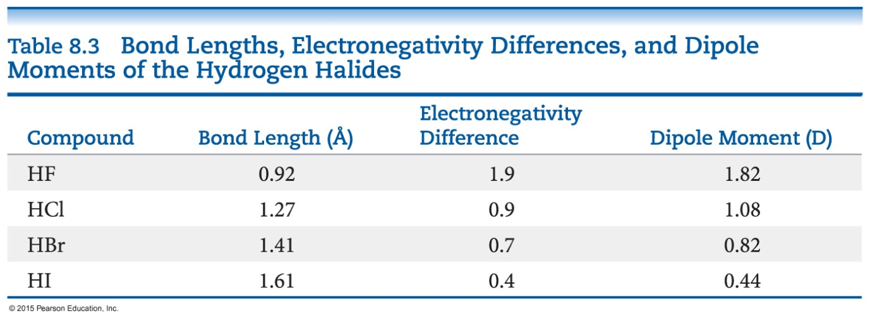
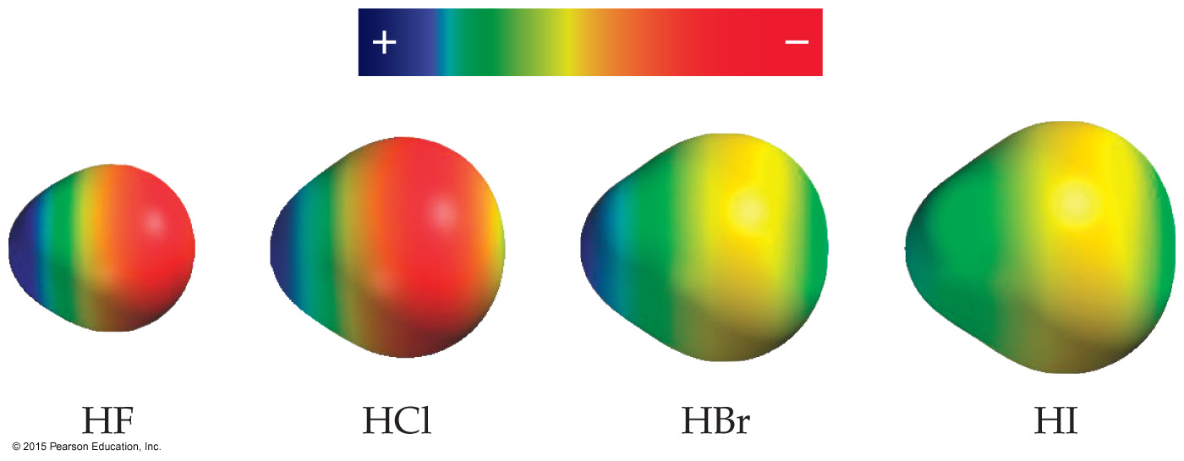
Polar Covalent Bonds
The greater the difference in electronegativity, the more polar is the bond.
Which is the most polar bond?

Slide 17
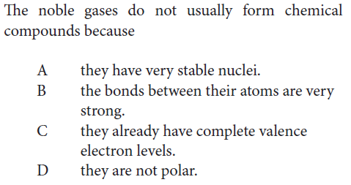
Practice

Slide 18
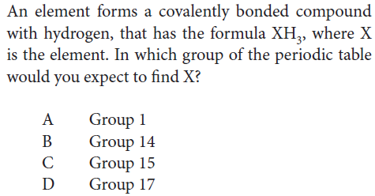
Practice

Slide 19
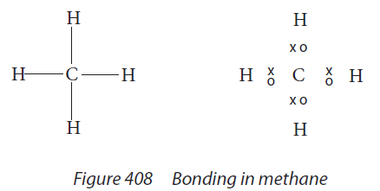
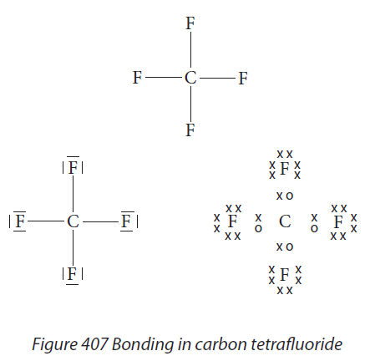
Lewis structure/Lewis dot diagram
Lewis structures (also known as Lewis dot diagrams,) are diagrams that show all the valence electrons of the atoms involved (the bonding between atoms of a molecule and the lone pairs of electrons that may exist in the molecule).
Which is Lewis structure, which is not?

Slide 20

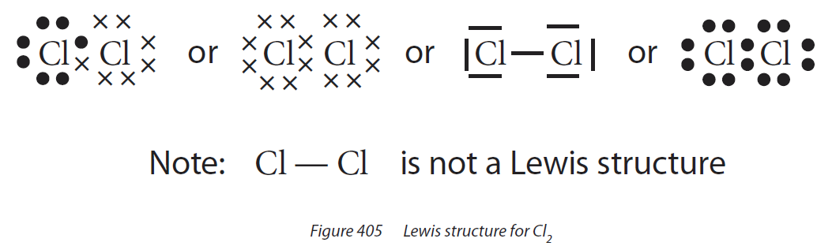
Lewis structure/Lewis dot diagram

Slide 21
Electrons on Lewis Structures
Lone pairs: electrons located on only one atom in a Lewis structure
Bonding pairs: shared electrons in a Lewis structure; they can be represented by two dots or one line

Slide 22
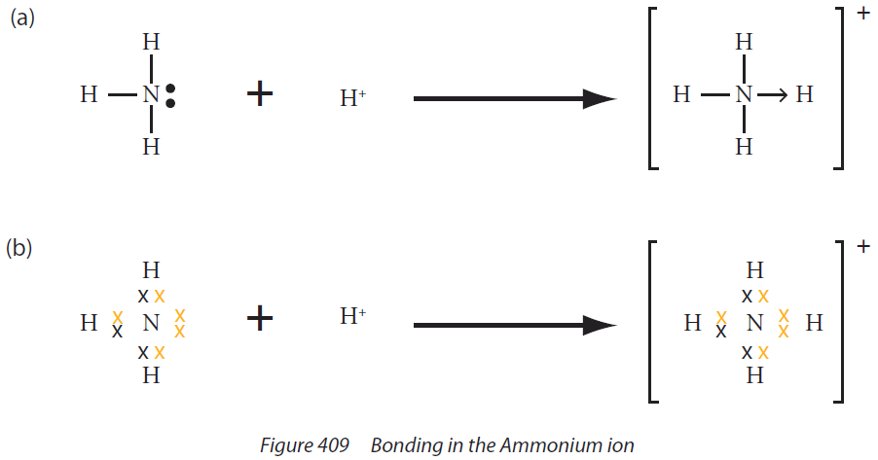
Dative covalent bond
Sometimes in a covalent bond both of the electrons that form the bond originate from the same atom. A bond of this type is known as dative bond, and often indicated by an arrow pointing in the direction the electron pair is donated.
CO

Slide 23
Strategy to draw Lewis diagram
Key steps:
1, Know the # of valence electron for each atom-----how many bond does each need.
2, All of the atoms follow octet rule (except. H).
3, Put the atom who need most bonds/extra electron to fulfill octet rule in the center.
4, Add electron for anion, remove electron for cation, use “[ ]^{Z}” for the charged molecule (Z is the charge)
Practice:
Draw lewis diagram for:
H₂O , NH₃ , CH₄ , C₂H₆ , C₂H₄ , C₂H₂ , OH⁻ , HCN , HCO₂⁻ , O₂ , N₂, CO, SO₂

Slide 24
Writing Lewis Structures (Covalent Molecules)
Sum the valence electrons from all atoms, taking into account overall charge.
If it is an anion, add one electron for each negative charge.
If it is a cation, subtract one electron for each positive charge.
PCl₃
Keep track of the electrons:
5 + 3(7) = 26

Slide 25
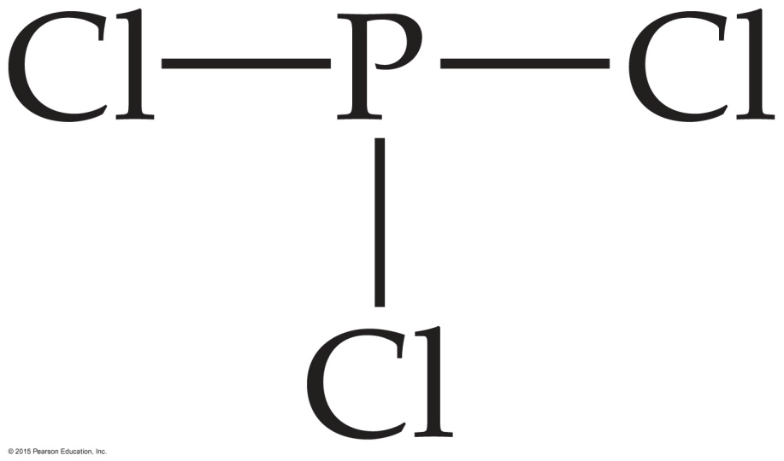
Writing Lewis Structures
Write the symbols for the atoms, show which atoms are attached to which, and connect them with a single bond (a line representing two electrons).
Keep track of the electrons:
26 − 6 = 20

Slide 26
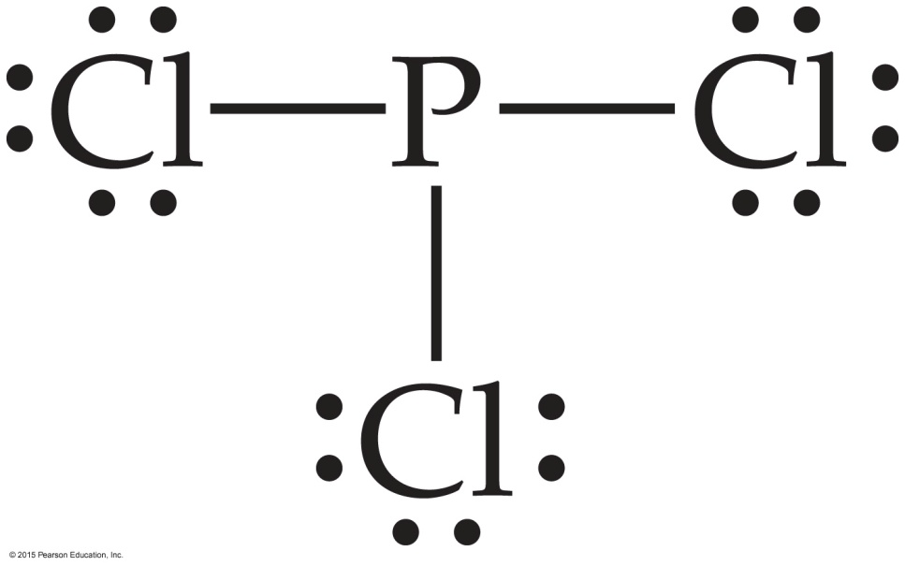
Writing Lewis Structures
Complete the octets around all atoms bonded to the central atom.
Keep track of the electrons:
26 − 6 = 20; 20 − 18 = 2

Slide 27
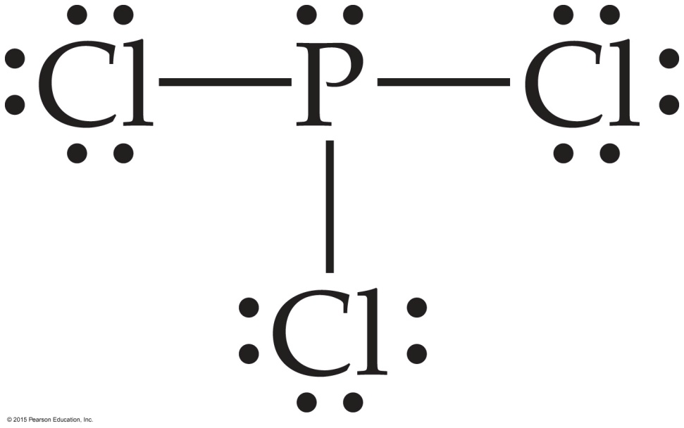
Writing Lewis Structures
Place any leftover electrons on the central atom.
Keep track of the electrons:
26 − 6 = 20; 20 − 18 = 2; 2 − 2 = 0

Slide 28

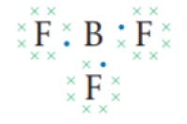
The octet rule is not always followed
There are a few molecules that are exceptions to the octet rule. Small atoms such as beryllium (Be) and boron (B) form stable molecules in which the central atom has fewer than eight electrons in its valence shell. This is known as an incomplete octet. For example, the structures of BeCl₂ and BF₃ are shown below.
Fewer Than Eight Electrons

Slide 29
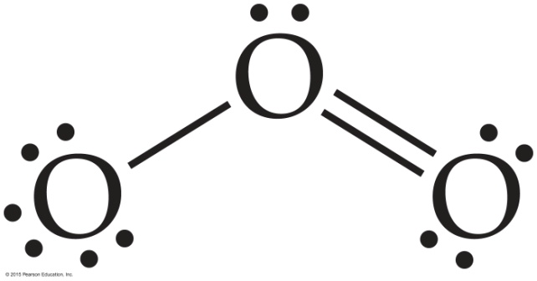
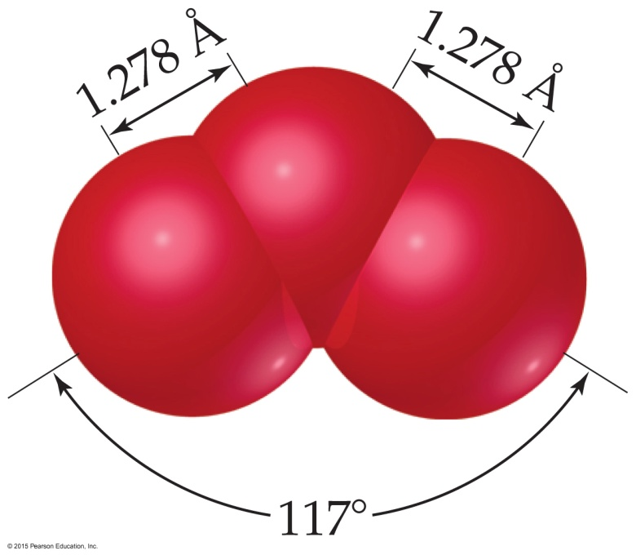
The Best Lewis Structure?
Following our rules, this is the Lewis structure we would draw for ozone, O₃.
However, it doesn’t agree with what is observed in nature: Both O to O connections are the same.
Notes:
Start here 6/11/10

Slide 30
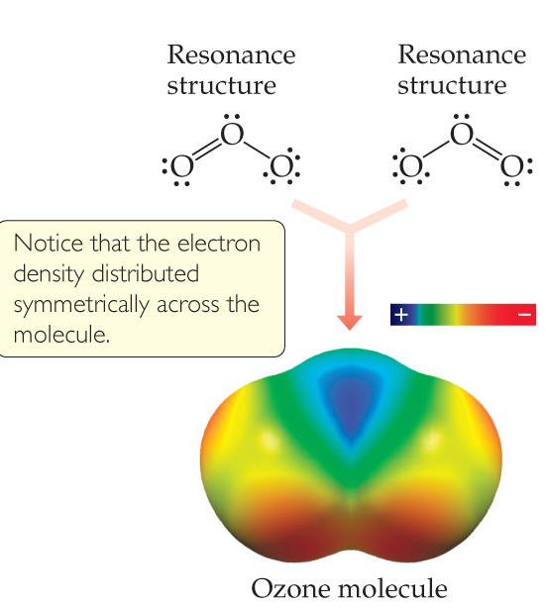
Resonance
One Lewis structure cannot accurately depict a molecule like ozone.
We use multiple structures, resonance structures, to describe the molecule.

Slide 31
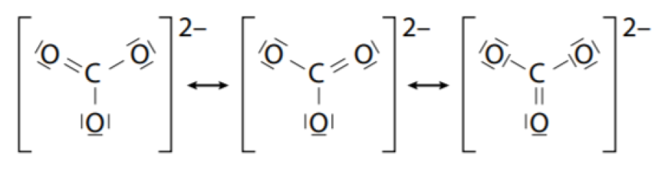
Resonance structures
There is more than one way of drawing the structure of the CO₃ ²⁻ ion depending on where we put the C=O (and lone pairs). These individual structures differ only in the position of the double bond and are called resonance structures. In CO₃ ²⁻, the carbon– oxygen bonds are equal in length in benzene the carbon–carbon bonds are all identical.

Slide 32
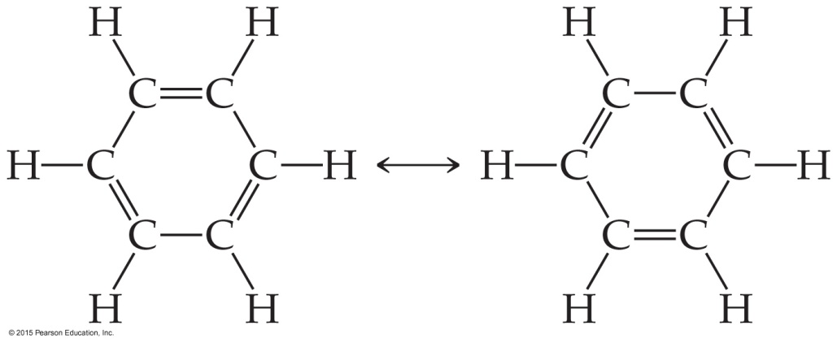

Resonance
The organic compound benzene, C₆H₆, has two resonance structures.
It is commonly depicted as a hexagon with a circle inside to signify the delocalized electrons in the ring.
Localized electrons are specifically on one atom or shared between two atoms; Delocalized electrons are shared by multiple atoms.

Slide 33
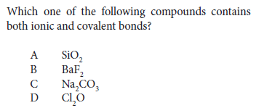
Practice
Handout P106 Q5

Slide 34
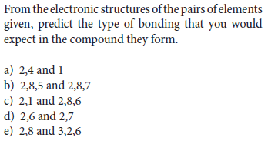
Practice
Handout P106 Q7

Slide 35
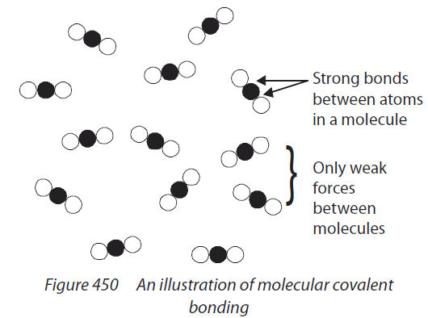
Molecular covalent solid
The covalent bonds hold a small number of atoms together to form discrete units called Molecules.

Slide 36
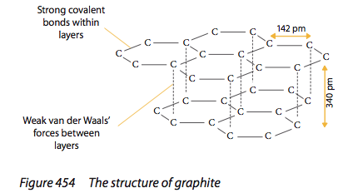
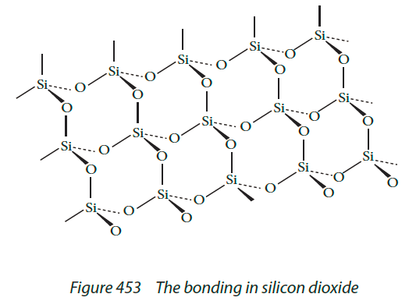
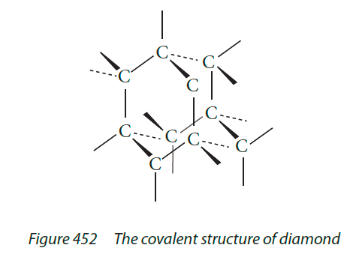
Giant covalent solid/covalent network solid

Slide 37
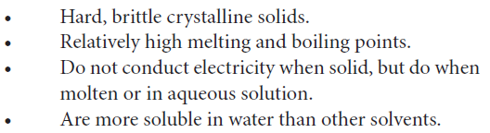
Properties of molecular covalent solid V.S. Ionic compounds
Quite soft in the solid state
Have low m.p. and b.p. (often existing as liquids or gases at RM T&P)
Do not conduct electricity
Are more soluble in non-polar solvents than in water
Ionic compounds

